Slide 1

NetVRM: Virtual Register Memory for Programmable Networks
Hang Zhu
Tao Wang, Yi Hong, Dan R. K. Ports, Anirudh Sivaraman, Xin Jin

Slide 2
Data plane objects
Stateless (lifespan <= 1 packet)
Stateful (lifespan > 1 packet)
Metadata, packet headers
Tables, counters, meters, registers
Registers enable a new class of
reg-stateful applications

Slide 3
The case of dynamic allocation for register memory
Necessity
Limited register memory (e.g., a few Mb/stage)
Concurrent reg-stateful applications
Potential benefits
Diminishing return

Slide 4
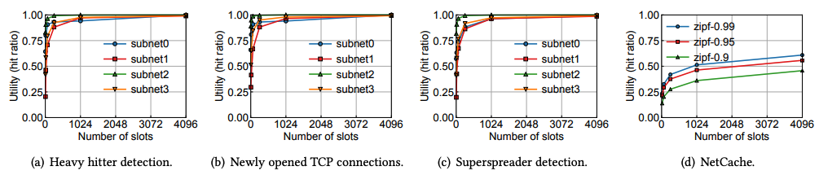
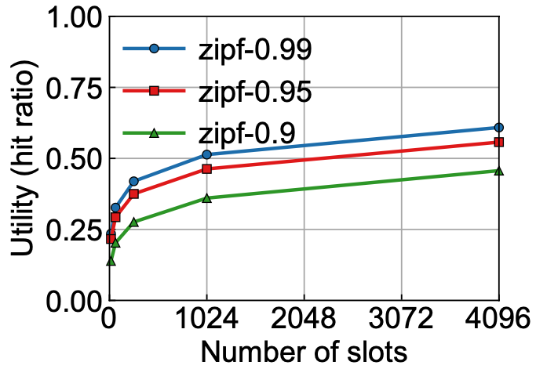
Diminishing return
NetCache with different skewed workload
Diminishing return: the benefit of additional memory decreases with the amount of allocated memory
0.28->0.36: 768 register slots
0.36->0.46: 3072 register slots

Slide 5
Existing solutions and limitations
Static binding of
register memory
Ignore hardware constraints
No network-wide dynamic allocation
Merged in compilation time
P4Visor [CoNEXT’18]
DPDK, BMv2
Hyper4 [CoNEXT’16]
Allocation in a single switch

Slide 6
Realizing dynamic register memory allocation
How to enable online allocation
Virtual register memory
How to modify P4 programs
P4VRM compiler
How to maximize
multiplexing benefits
Dynamic allocation

Slide 7

NetVRM architecture
xx.p4vrm
Dynamic Memory Allocation
xx.p4vrm
App 1
App 2
App 3
Control
Plane
Virtual Register Memory
NetVRM
P4VRM
Compiler
Run-time API
Data
Plane
…
zoom in
Network

Slide 8
Virtual register memory
App 1
App 2
App 3
Page tables
Counter record
App
Control
Plane
Virtual
Array
Virtual Register Memory
NetVRM
Page
Table
Counter
Record
Match | Action
app=1 | offset=0, size=16k
app=2 | offset=16k, size=16k
app=3 | offset=32k, size=32k
0
…
16k
…
32k
…
…
…
0
…
16k
…
32k
…
…
…
0
…
16k
…
32k
…
…
…
0
…
16k
…
32k
…
…
…
total_cnt
hit_cnt
total_cnt
hit_cnt
total_cnt
hit_cnt
…
…
Data
Plane
Page Table
Multi-stage Physical Register Arrays
Counter
Record

Slide 9
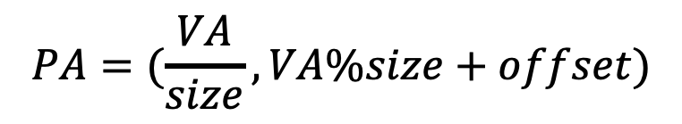
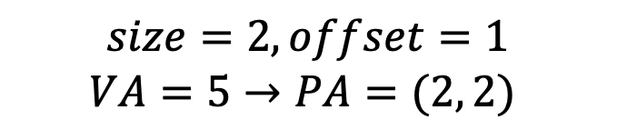
Address translation
0 1 2 3
0
1
2
3
4
5
6
7
4
5
0
1
2
3
6
7
Translation formula
$$PA=(\frac{VA}{size}, VA\%size+offset)$$
physical array index
physical slot index
$$size=2, offset=1$$
$$VA=5→PA=(2, 2)$$

Slide 10
NetVRM architecture
xx.p4vrm
Dynamic Memory Allocation
xx.p4vrm
App 1
App 2
App 3
Control
Plane
Virtual Register Memory
NetVRM
P4VRM
Compiler
Run-time API
Data
Plane
…
zoom in
Network

Slide 11
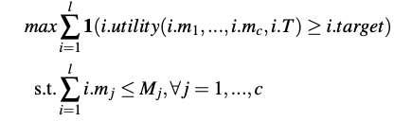
Problem formulation
Objective
Maximize number of applications with satisfied utility target
Constraints
Register memory constraints on each switch

Slide 12
Scope of dynamic resource allocation
Elastic applications
Inelastic applications
Work with a variable amount of register memory
Overcome insufficient register memory with a fallback mechanism
Require a fixed amount of register memory
Cannot work with less
benefit
support

Slide 13
Challenges for dynamic resource allocation
Definition of
application utility
Memory hit ratio
by default
Unknown and dynamic utility functions
Multiple paths of an application

Slide 14


Memory hit ratio by default
m packets processed by register memory
n packets
Application-agnostic
Reflect application-level performance
Computed online
n-m packets
Fallback mechanism
$$hit ratio= \frac{m}{n}$$

Slide 15
Challenges for dynamic resource allocation
Definition of
application utility
Memory hit ratio
by default
Unknown and dynamic utility functions
Online utility
curve estimation
Multiple paths of an application

Slide 16
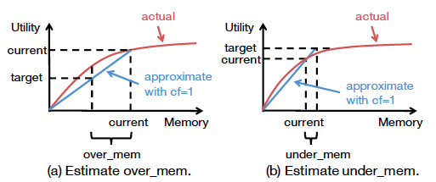
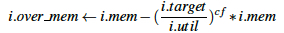
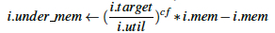
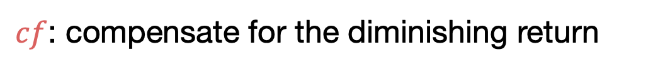
Online utility curve estimation
$cf$: compensate for the diminishing return

Slide 17
Dynamic resource allocation
Definition of
application utility
Memory hit ratio
by default
Step 1: decompose over_mem and under_mem
Step 2: over_mem -> under_mem
Unknown and dynamic utility functions
Online utility
curve estimation
Multiple paths of an application
Network-wide register memory allocation

Slide 18
NetVRM architecture
xx.p4vrm
Dynamic Memory Allocation
xx.p4vrm
App 1
App 2
App 3
Control
Plane
Virtual Register Memory
NetVRM
P4VRM
Compiler
Run-time API
Data
Plane
…
zoom in
Network

Slide 19
P4VRM compiler
Step 1: developers extend .p4 to .p4vrm
Mark the register arrays and related declarations as virtualized

Slide 20
P4VRM compiler
Step 1: developers extend .p4 to .p4vrm
Step 2: compiler outputs .p4 and .cpp

Slide 21
Implementation
6.5 Tbps Intel Tofino switch
Four emulated switches with four independent pipelines
P4VRM compiler
built on Flex/Bison

Slide 22
Evaluation
Microbenchmark
Control loop delay
Stability and fast convergence of NetVRM
Macrobenchmark
Generality
Impact of allocation epochs
Impact of workload parameters
NetVRM in datacenter network

Slide 23
Evaluation
Microbenchmark
Control loop delay
Stability and fast convergence of NetVRM
Macrobenchmark
Generality
Impact of allocation epochs
Impact of workload parameters
NetVRM in datacenter network

Slide 24
Control loop delay
One reallocation can be done in ~10 ms
Reconfig dominates the control loop

Slide 25
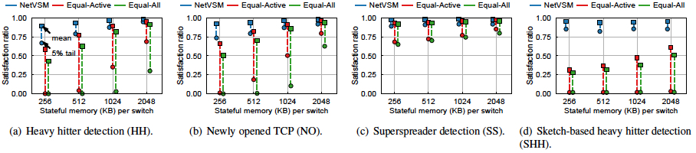
Generality
Each application has traffic from four switches independently
Satisfaction ratio as the performance metric
Alternatives: Equal-All, Equal-Active
NetVRM outperforms alternatives on both the mean and the tail
NetVRM is general to different network application types

Slide 26
Impact of allocation epochs
A shorter allocation epoch leads to a better performance

Slide 27
Conclusion
NetVRM supports dynamic register memory sharing between multiple concurrent applications on a programmable network
Virtual register memory: enable online register memory sharing
Dynamically allocate memory for better resource efficiency
P4VRM: easily equip the programs with virtual register memory

Slide 28
Thank you!
E-mail address: hzhu@jhu.edu

